Slide 1
Market Analysis 2
Personal Finance & Investing SDG
Amy, Judha, Victoria
Notes:
Change the slide background colour to any of the Primary colours (except yellow)

Slide 2
SCOTIABANK DIGITAL BANKING DECK TEMPLATE
Agenda
01
02
03
04
05
“Bad news is good news” for the market
CPI Report
Sector Analysis – US and CAN real estate
Sector Analysis – Market Trends and perspectives
Discussion
Notes:
01, 02 (Judha), 03 (Victoria), 04 (Amy)

Slide 3
“Bad news is good news”
00 SUBSECTION NAME
3
RIGHT NOW, bad news for individual economies is actually good news for the market. This is because markets are very emotional right now, with selling and buying happening in massive volumes at the drop of a hat. Right now, the markets are convinced that central banks are on mission to tame inflation, no matter the cost. This generally means that markets fear inflation and a hot economy.
Notes:
A hot economy means that people are being paid more, stores are selling out of goods and people are spending cash. When this happens, inflation tips forward (peoples spending power is increasing and stores are forced to up their prices so that they can match supply with demand. I think most of us know that when stores raise prices, demand for the good goes down. Stores know this too, so they raise prices to ensure that they have enough goods to sell to the people who want it the most. This is inflation in action. When stores raise their prices and people keep on buying, we run into a bad situation where supply cannot meet demand – which we saw in much action in the last two years with semiconductors and used cars. No one wants prices to keep on going to the moon, so the federal reserve is raising the cost of capital. (COST OF CAPITAL = the cost associated with obtaining the capital needed to do an action.) in this case, its interest rates. The cost of borrowing the money to purchase that car, or to finance that TV purchase. By raising the cost of capital, less people can afford the prices associated with borrowing money to purchase a good. With less purchasing power, people stop being able to buy that used car which is now more expensive to buy used than it was to buy new a year ago. (we saw this a lot in the used car market)

Slide 4
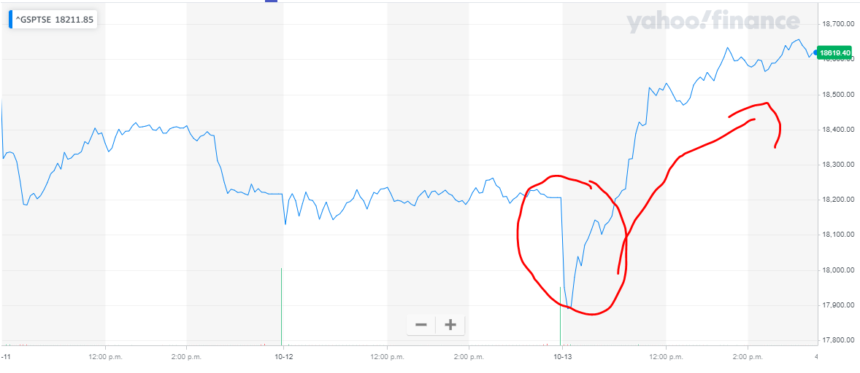
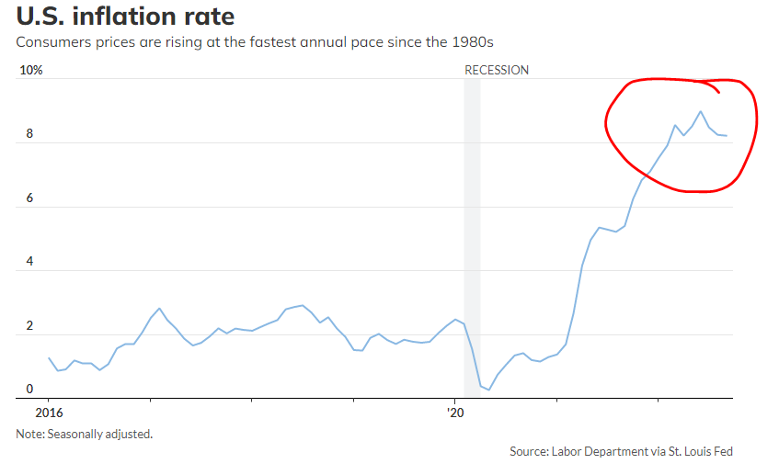
00 SUBSECTION NAME
4
CPI Report
CPI came hot, but not hotter than last month. Lower than the last report (which was 8.3%) > we came at 8.2%. Expectations thought that 8.1% would be the target (which represents the selloff) but I guess people are celebrating the small wins.
Lower than 8% (7.9%) would have been very good for the markets and the general economy which would break the 8% psychological barrier and allow people to think that inflation is cooling down.
Notes:
The is the consumer price index that came out on Thursday (yesterday). This data gave the market an idea of how inflation has been affecting consumers. We saw an expectation before the report at 0.3%. (Month to month). The report came in and gave us a 0.4%. Not only that, but we also saw a crazy number on the yar on year core-cpi. Previously at 6.3%, the market was expecting a bump at 6.5% and praying for a dive lower, but we got a helium balloon instead. At 6.6% core-CPI was much higher than the markets wanted. At a 40-year high, no one wants this. This number has basically ensured that the US federal reserve will raise rates, and not slowly at that. It has almost guaranteed that the next rate hike will be at 0.75% and a greater than zero chance that it will increase to a 100-basis point hike, which – to explain - is a 1% increase in borrowing costs for pretty much everyone.

Slide 5
Sector Analysis – Real Estate
5
00 SUBSECTION NAME
5
Rates have more than doubled due to interest rate hikes
Traditional individual and family buyers are backing away
Supply for houses and land is high while demand is low
Presents opportunity for investors to buy at discounts
DISCUSSION: what are the pros/cons for homeowners vs buyers?
Retail vacancy at lowest rate in 15 years
More stores opened than closed in the past year
Retail real estate is doing very well compared to other real estate markets
In the US…
The average rate for a 30-year fixed-rate mortgage is 6.9% - its highest level since 2006

Slide 6
Sector Analysis – Real Estate
6
00 SUBSECTION NAME
6
In Canada…
Surge in variable rate mortgages in recent years
Mortgages, especially variable rate, have become very costly
Many holders at risk of meeting their trigger rate
Mortgage specialist estimates 350,000 trigger rate activations if rates hiked to 4%
Continued rise in immigration contributes to high demand, low supply
The rate for a 5-year fixed-rate closed mortgage is around 5.5%.

Slide 7
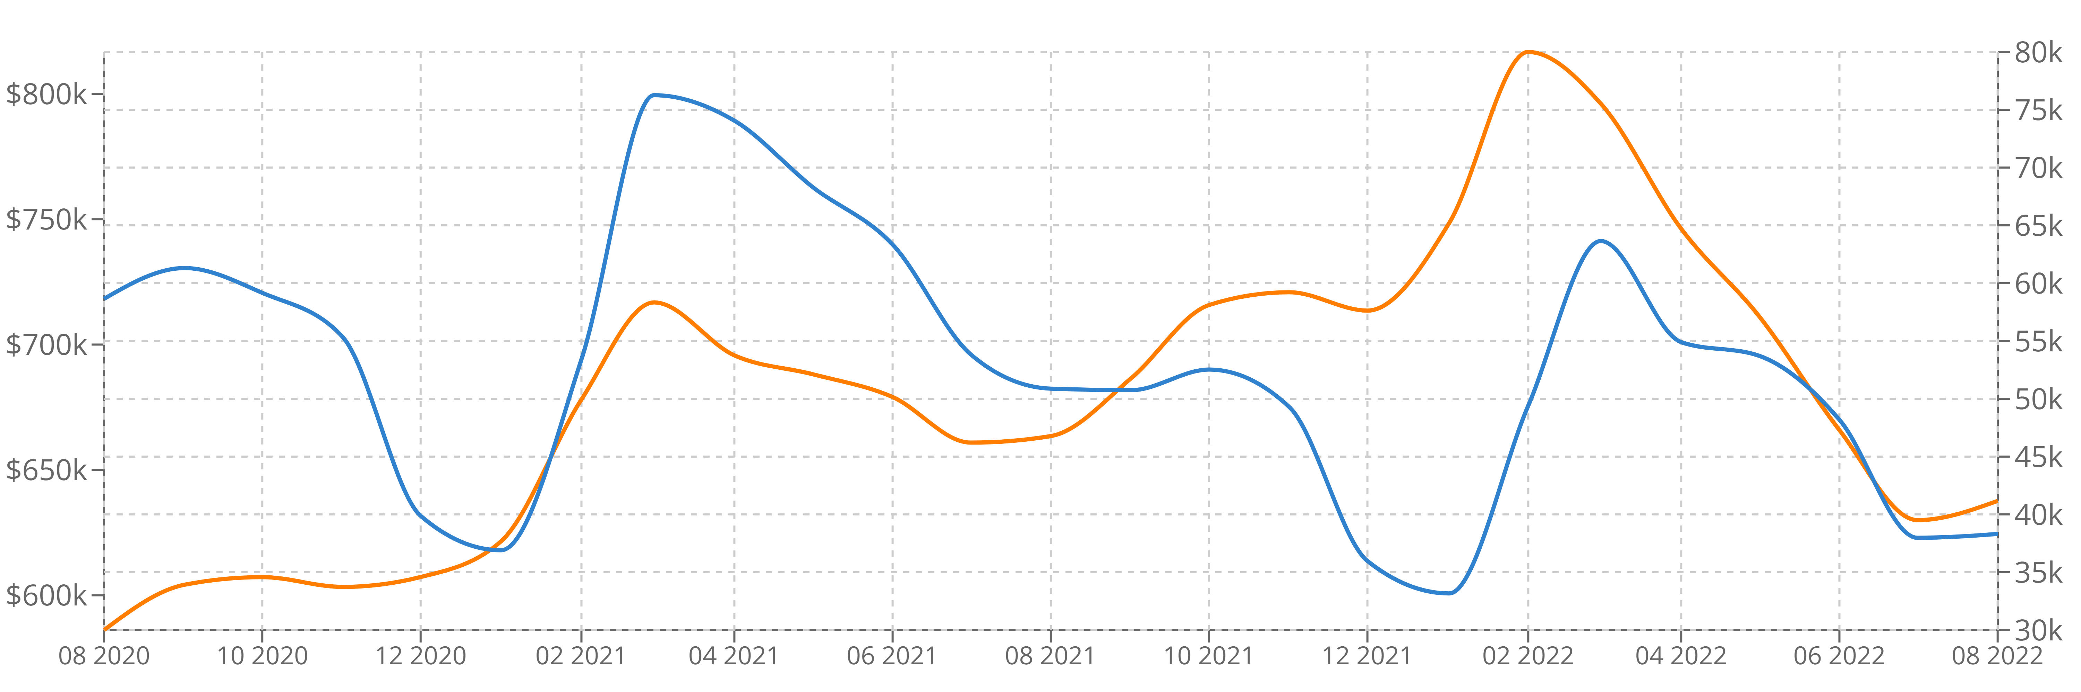
Sector Analysis – Real Estate​
00 SUBSECTION NAME
Real Estate Market Trends in Canada
Canada Real Estate Market Trends for All Property Types
(As of September 21)
We have seen the first increase ever since Febuarary, but is still 22% from that record. In the GTA area, only condo apartment had increase in sales price YOY. The market is still greatly affected by inflation and interest rate hikes
Average Sold Price Transactions​
Notes:
Killed purchase power

Slide 8
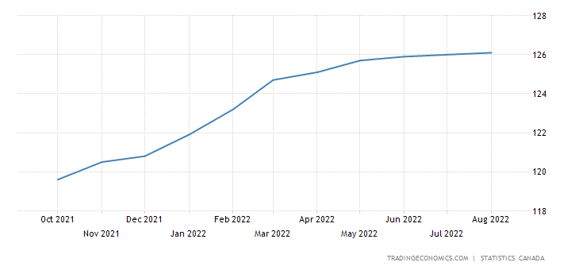
Sector Analysis – Real Estate​​
00 SUBSECTION NAME
Perspectives for Real Estate Market
New Housing Price Index
According to Remax, Condonium market share has grown this year. According to the New Housing Price Index(NHPI), with the inability to afford houses, the real estate market may continue to decrease somewhat in transaction in the upcoming months, but depending on the demand for houses
Notes:
Supply and demand(not enough houses for people/immigrants)
GTA increase in sales price.
Rental market is more popular since now is harder to buy houses
Housing bubble in Canada, and Toronto is huge. This would break soon

